Slide 1
Working with LLMs

Slide 2
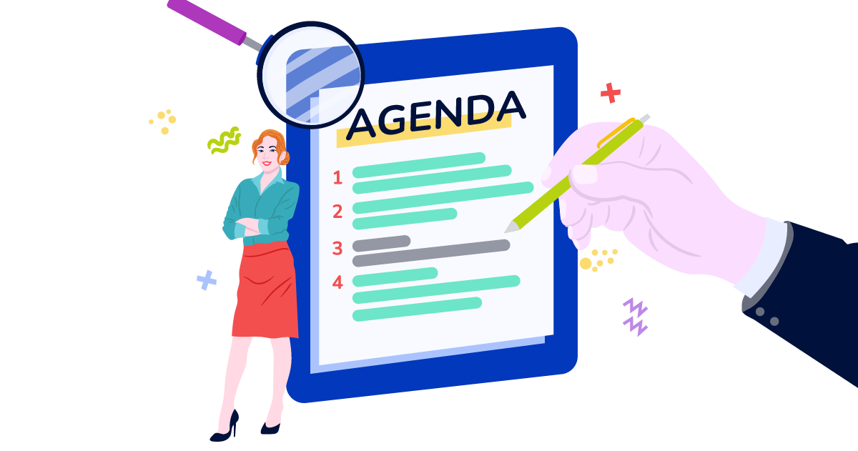
Agenda
Post-Training
Quick Recap on Retrieval Augmented Generation (RAG)
Supervised Fine-tuning (SFT), e.g., LoRA
Reinforcement Learning (RL), e.g., RLHF
Preparing for Deployment
Quantization & Distillation
Scaffolding for LLMs
Model Context Protocol (MCP)
MCP Clients, a.k.a. Harnesses (e.g., Claude Code, Cursor)
MCP Servers
Agentic Workflows, e.g., Vertex Agent Builder

Slide 3
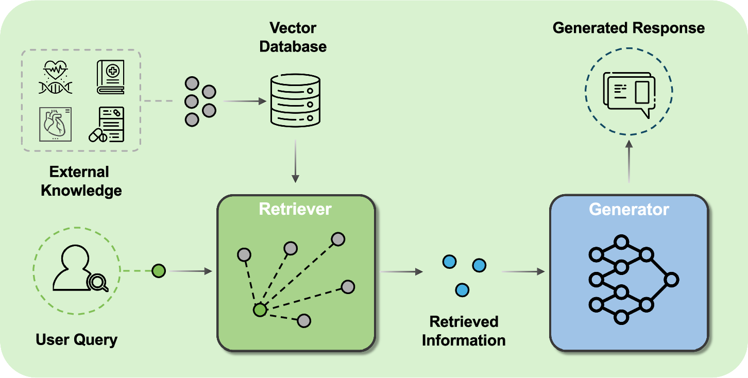
Retrieval Augmented Generation (RAG)
Given a prompt…
Retrieve relevant external knowledge, e.g., documents, by comparing embeddings (prompt vs. document).
Include external knowledge as context along with the prompt when generating answer.

Slide 4
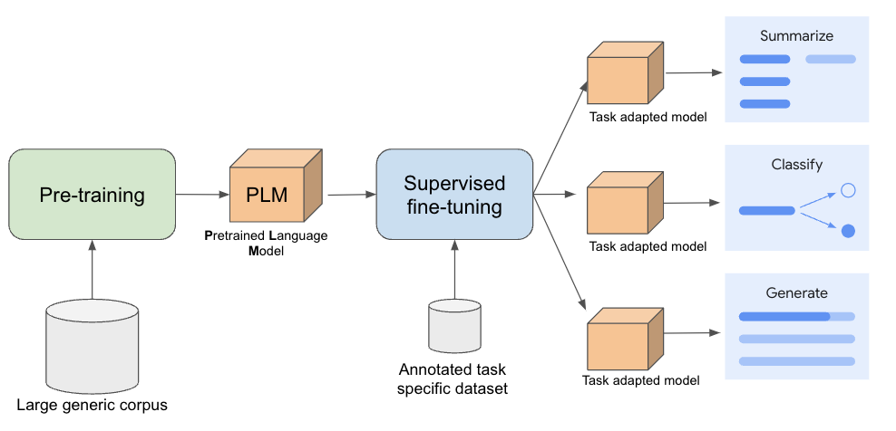
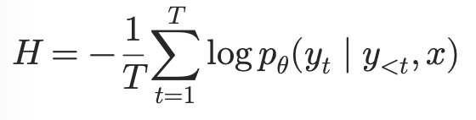
Supervised Fine-Tuning
Notes:
Conceptually, you go over the output label (generation) and for each token in the label, evaluate the model’s assigned probability to that token given the prompt + outputs up to that point. Just like cross entropy loss elsewhere, further away from the p = 1.0, the more penalized the output is. We average over all of the probabilities and back propagate. Perplexity here is the log of the average token loss.

Slide 5
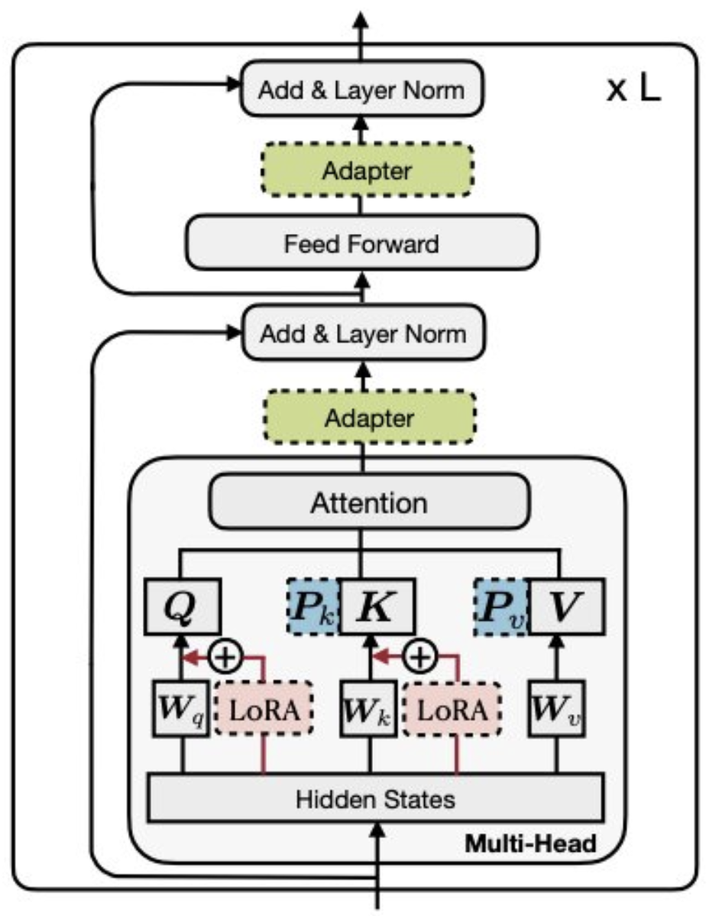
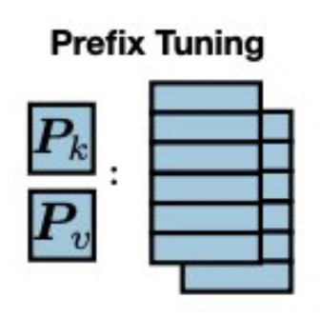
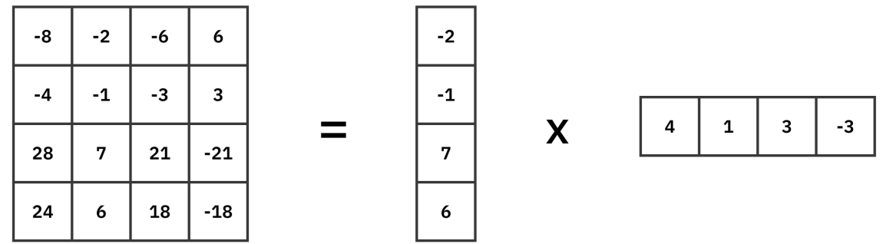
Prefix and Low-Rank Adaptor (LoRA) Fine-tuning
Prefix: We freeze the network and then add new trainable weight vectors that we prepend to the Q, K, and V vectors within the Transformer.
LoRA: We freeze the network, and we inject some new, small weight matrices that, when multiplied, yield a matrix of size W. We train these small ‘adapter’ weight matrices.

Slide 6
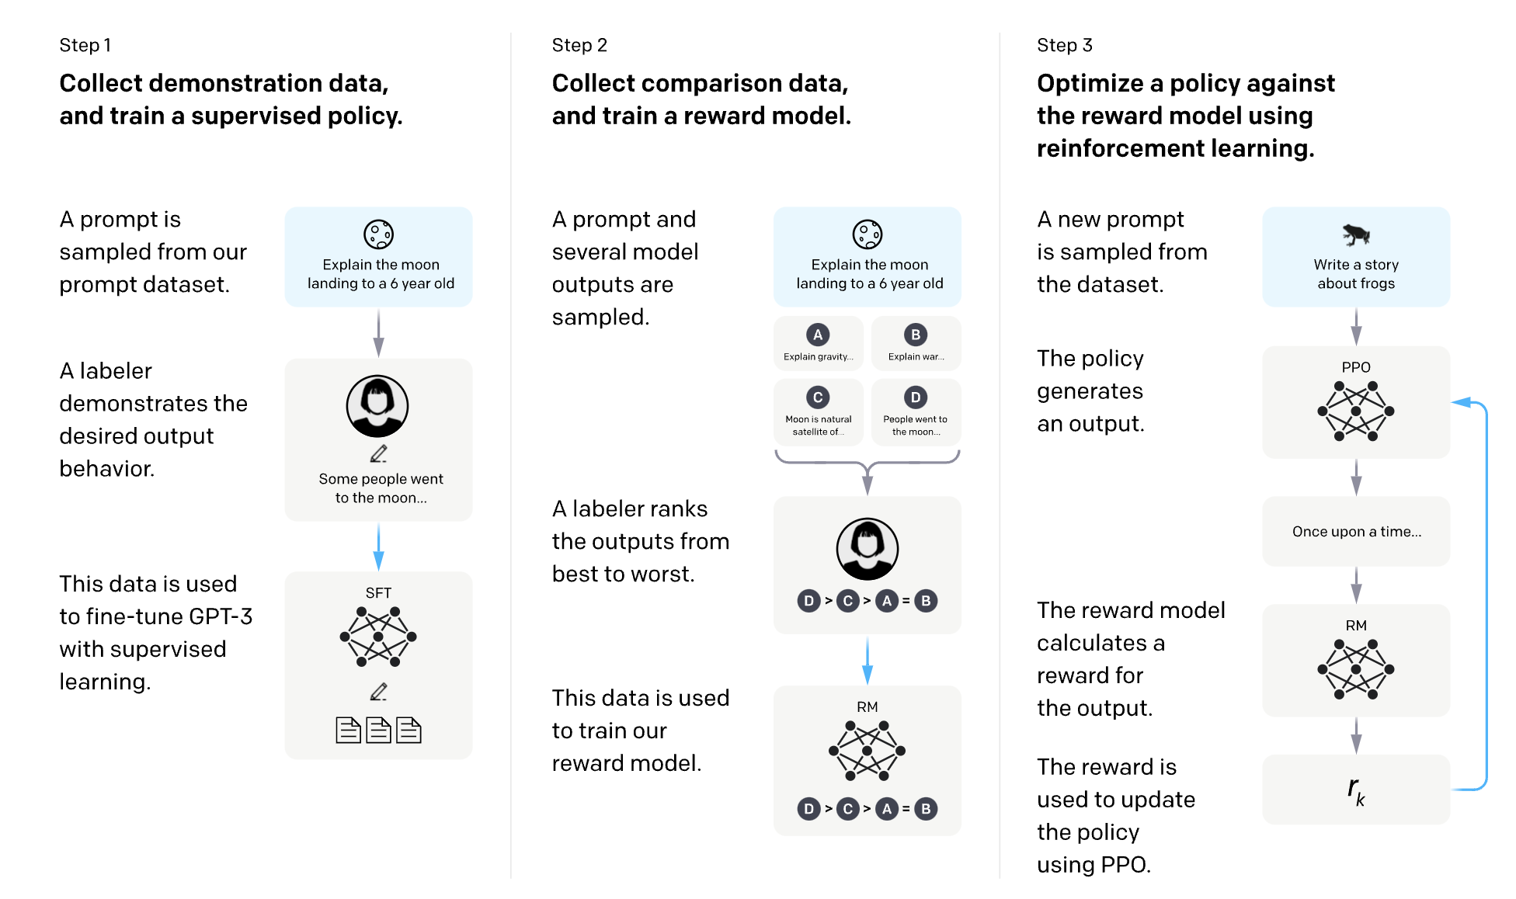
Reinforcement Learning from Scored Generations
Notes:
30-40k human preference ratings were enough to make this work.

Slide 7
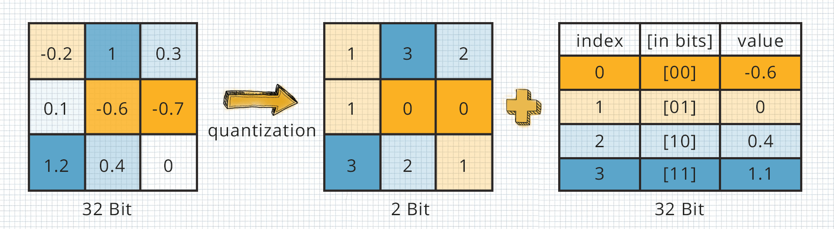
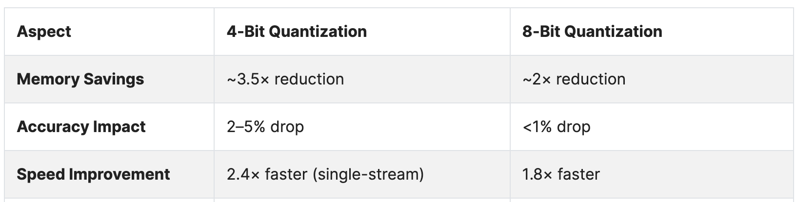
Quantization
Rounding Weights
We can reduce memory requirements by ‘discretizing’ the weights into integers rather than doubles/floats.
Some performance reduction, so there’s a trade-off, but enables use of a lower-memory device and faster inference.

Slide 8
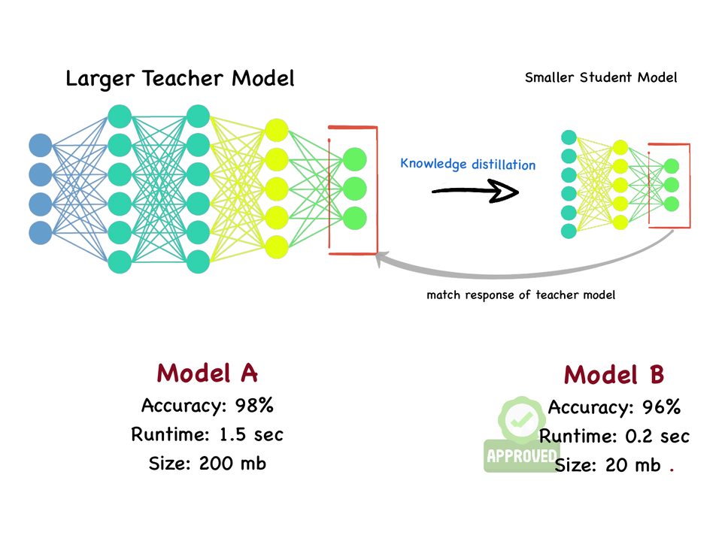
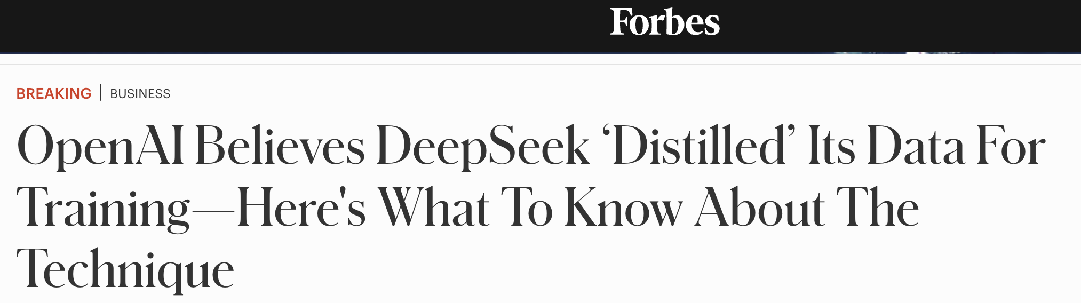
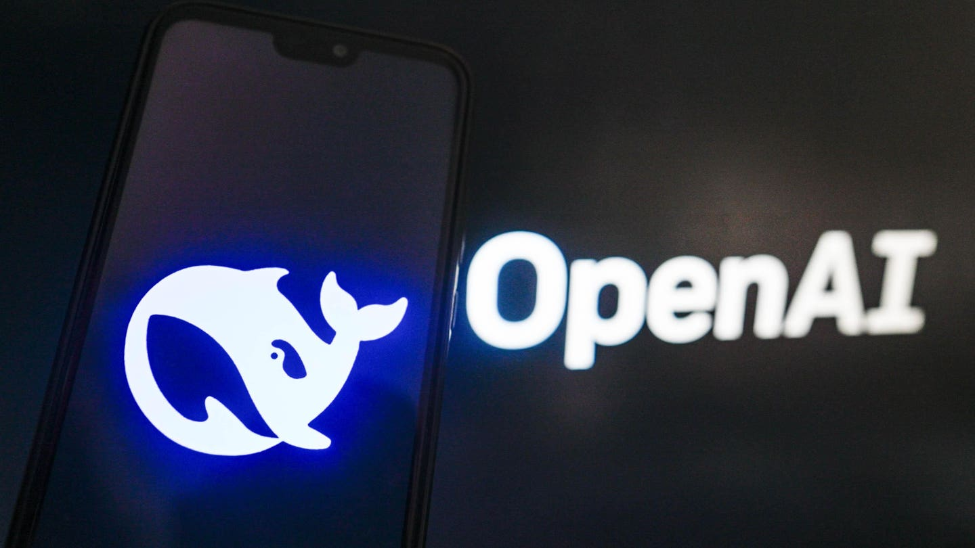
Distillation
Training a Smaller (Student) Model to Mimic a Bigger (Teacher) Model’s Output
Train a simple network to ‘mimic’ the responses of the bigger network.
Some performance loss, but results in smaller model, faster inference time.

Slide 9
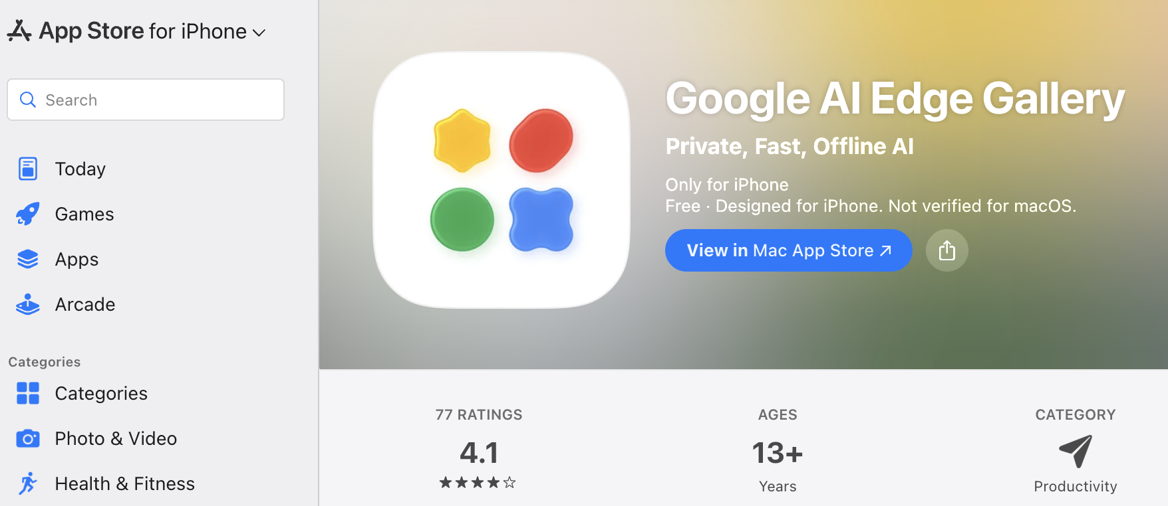
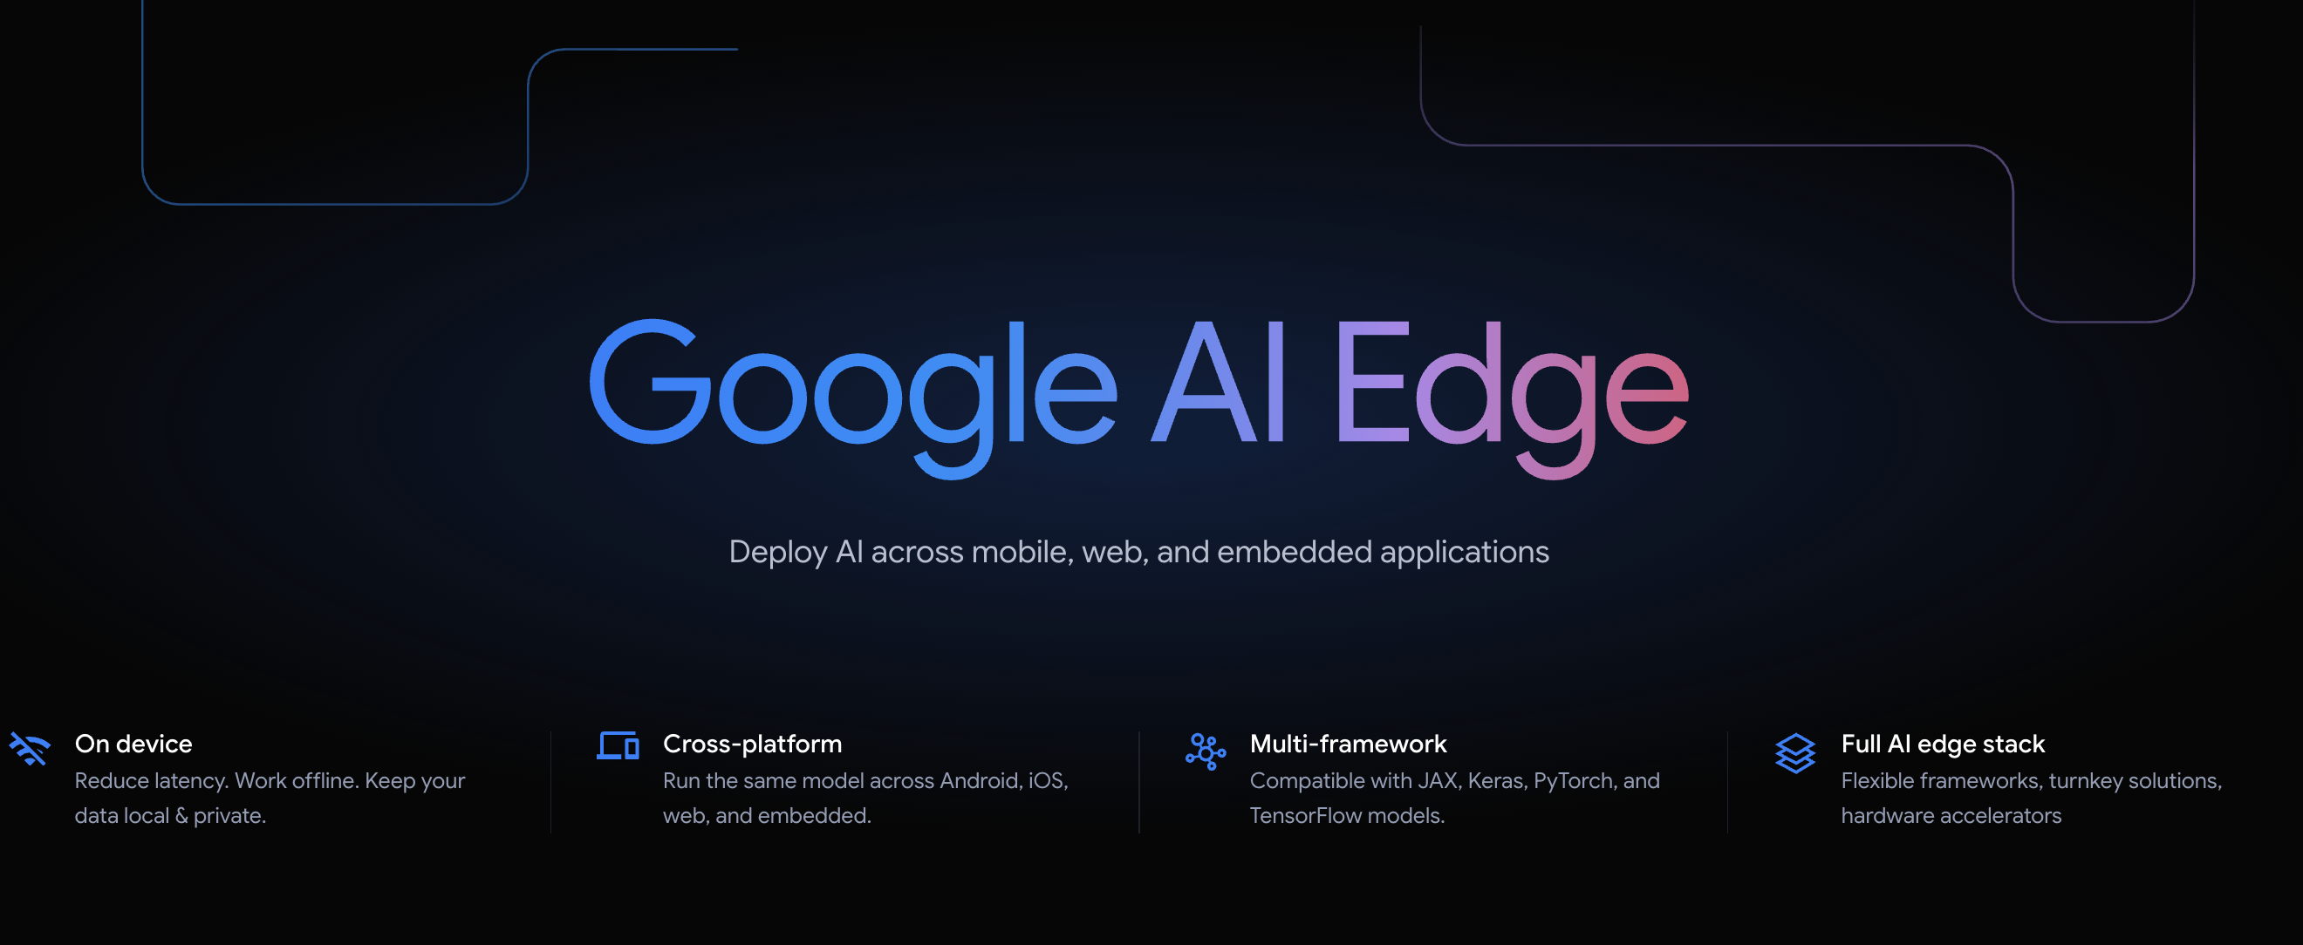
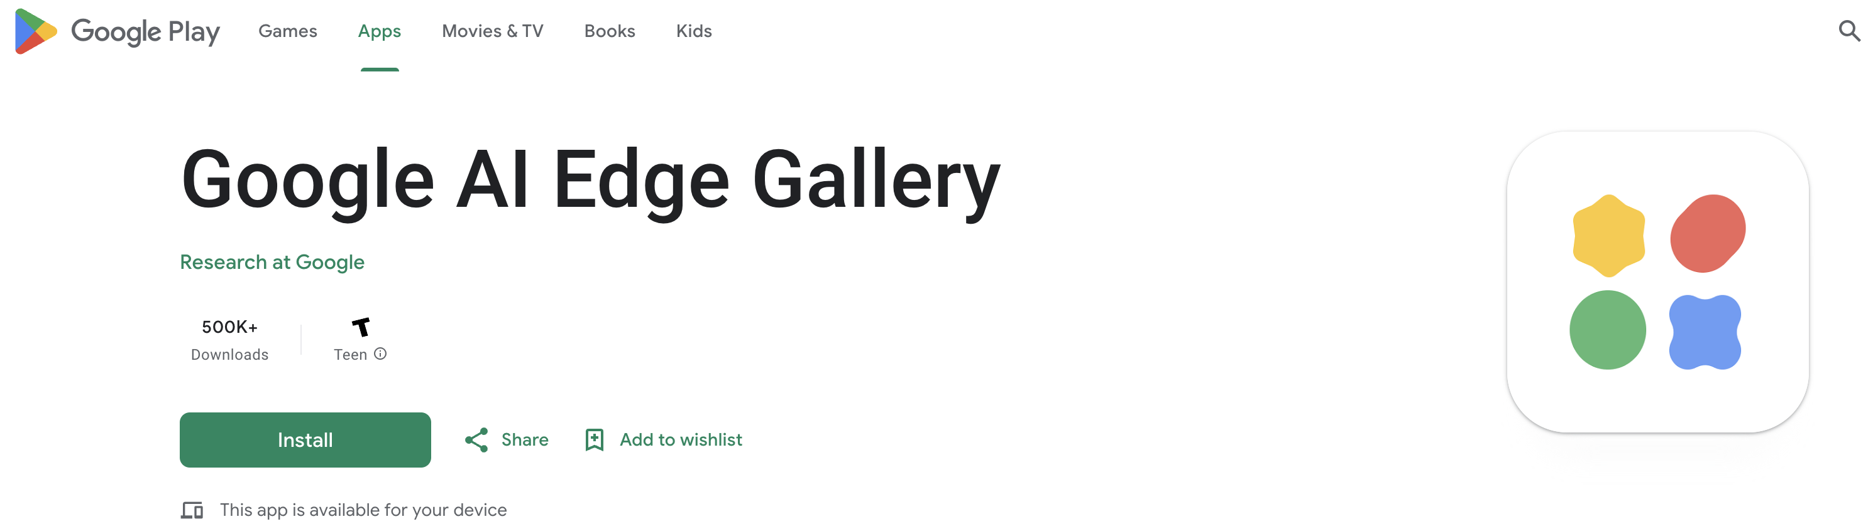
Deploying LLMs on Edge Devices

Slide 10
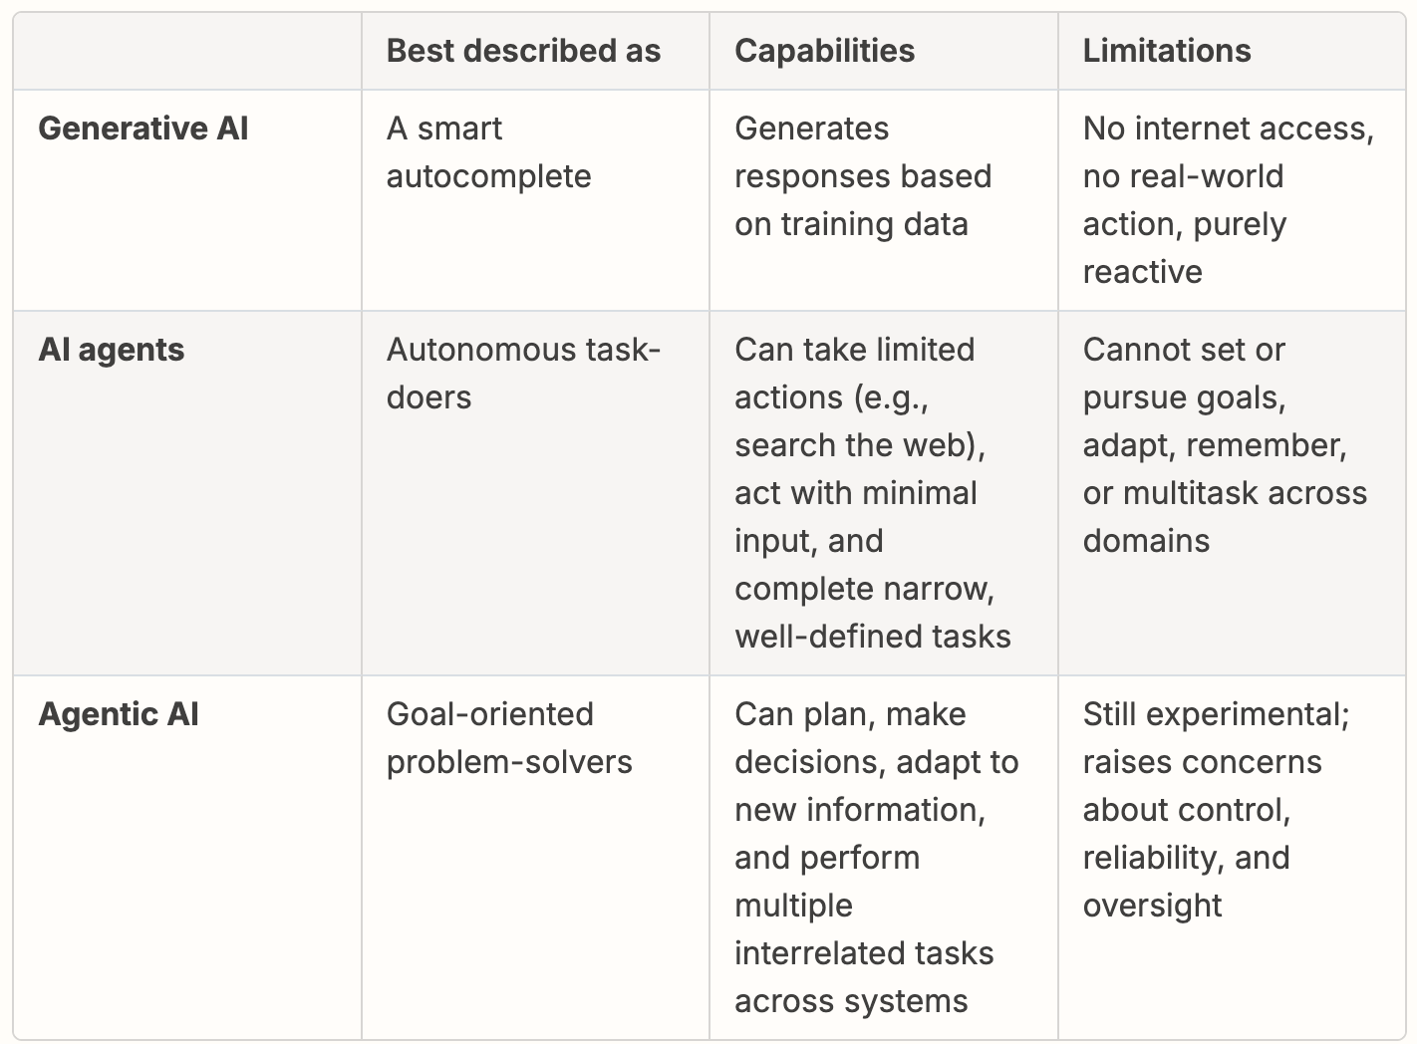
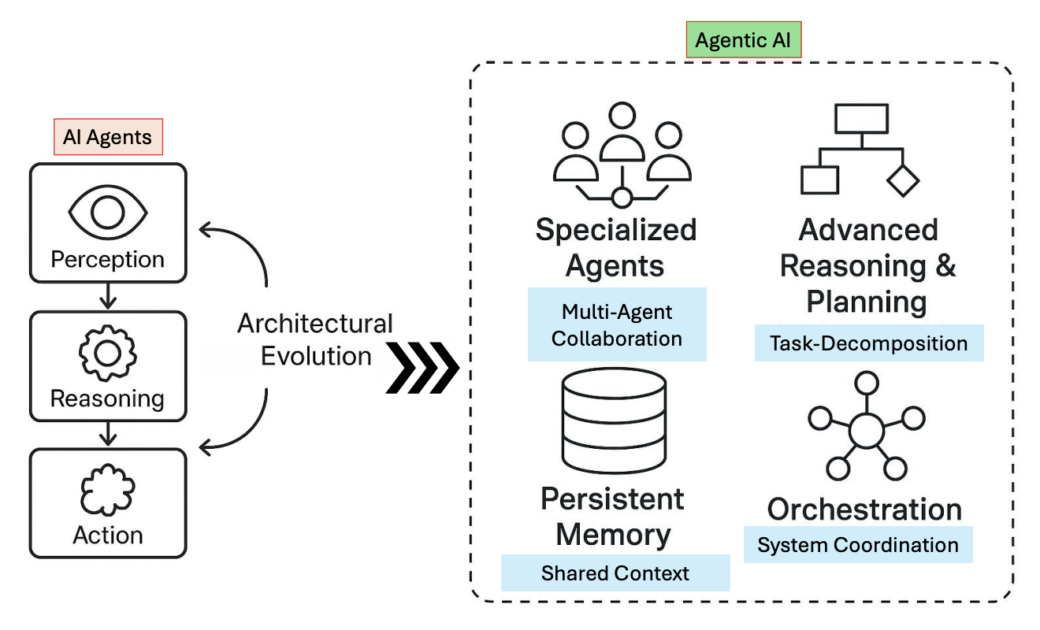
Agentic AI Goes Further. What Is It?

Slide 11
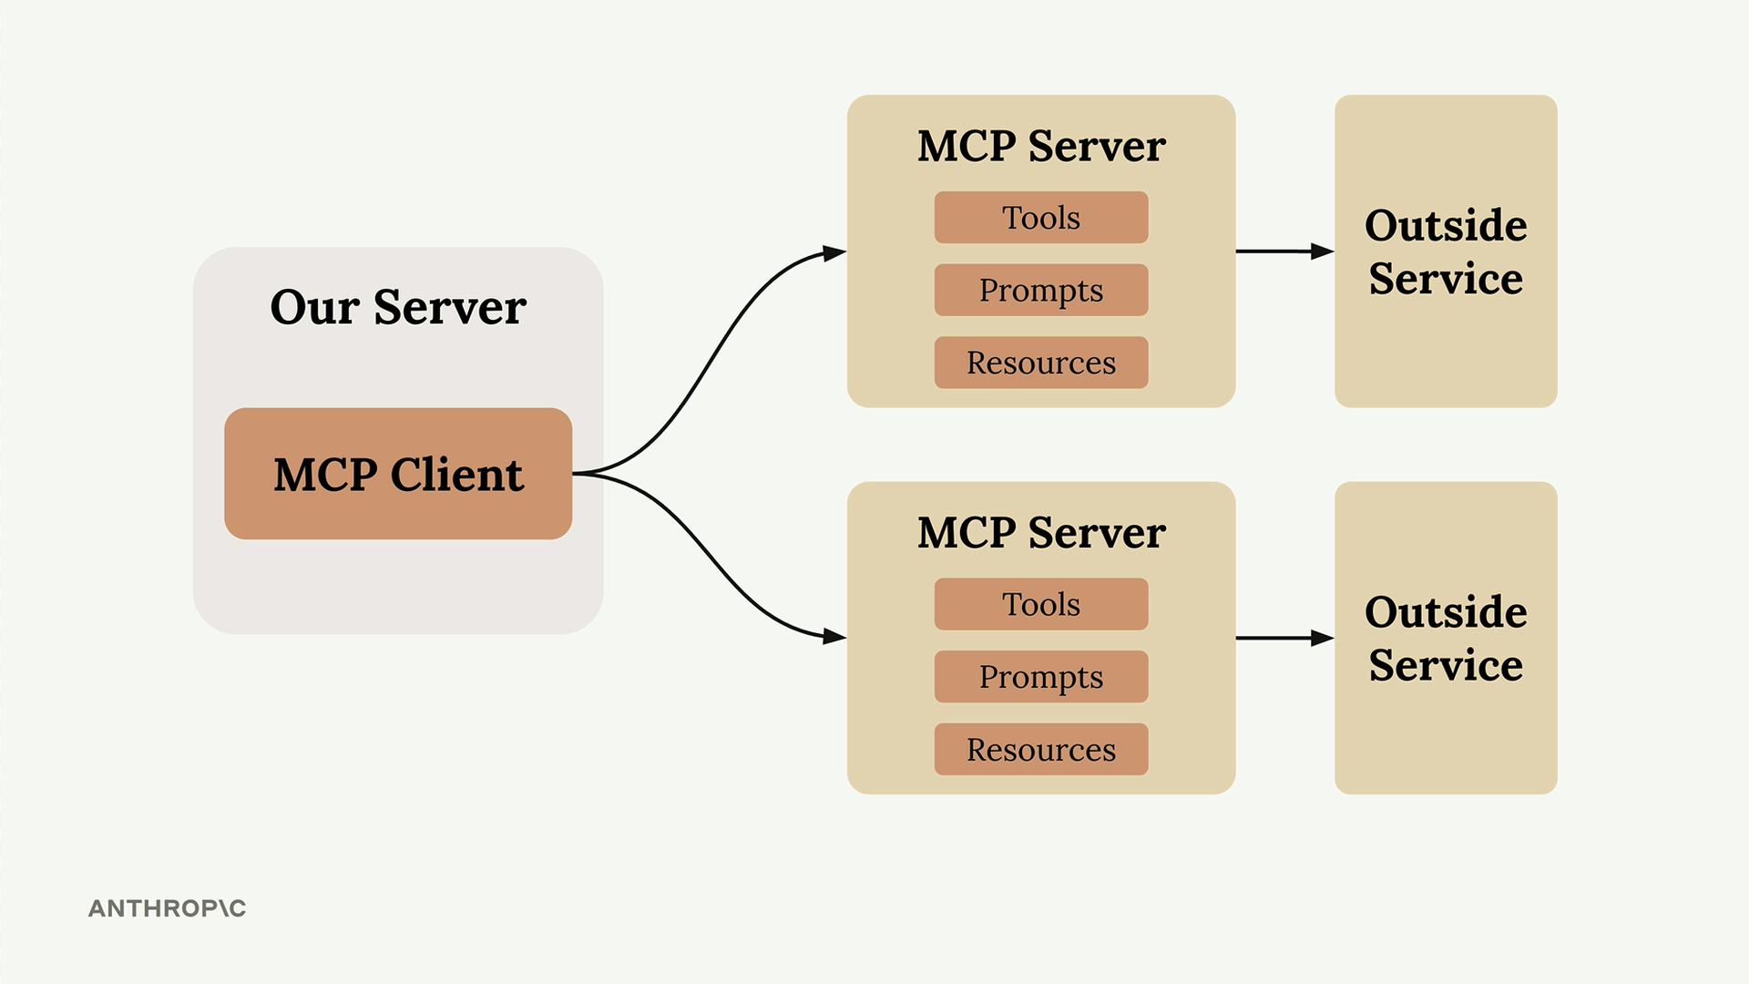
Model Context Protocol (MCP)

Slide 12
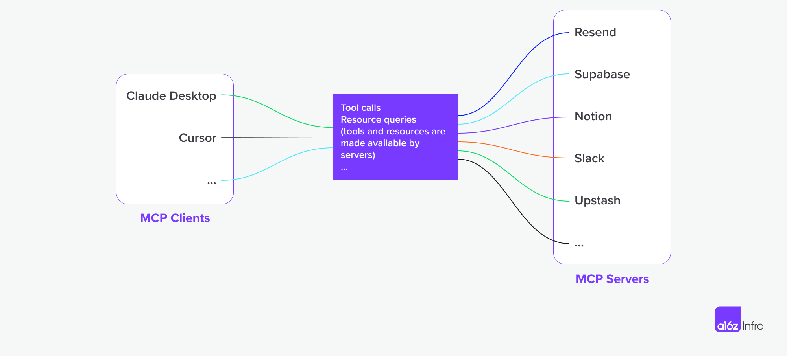
Model Context Protocol (MCP)

Slide 13
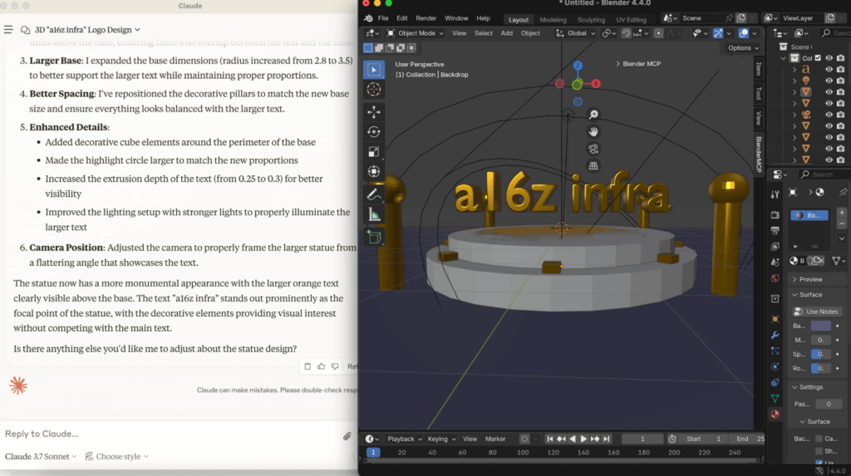
E.g., MCP Servers for Blender, Unreal Engine

Slide 14
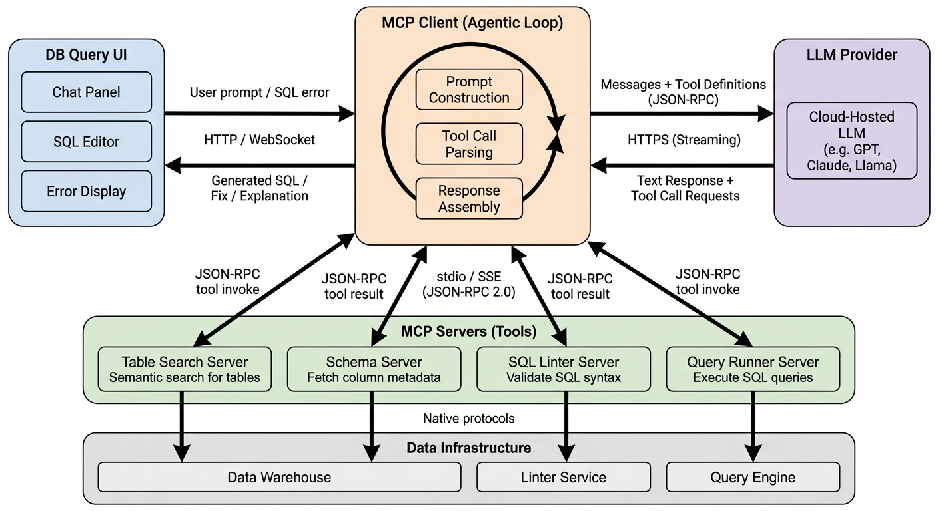
AI Agent Architecture

Slide 15
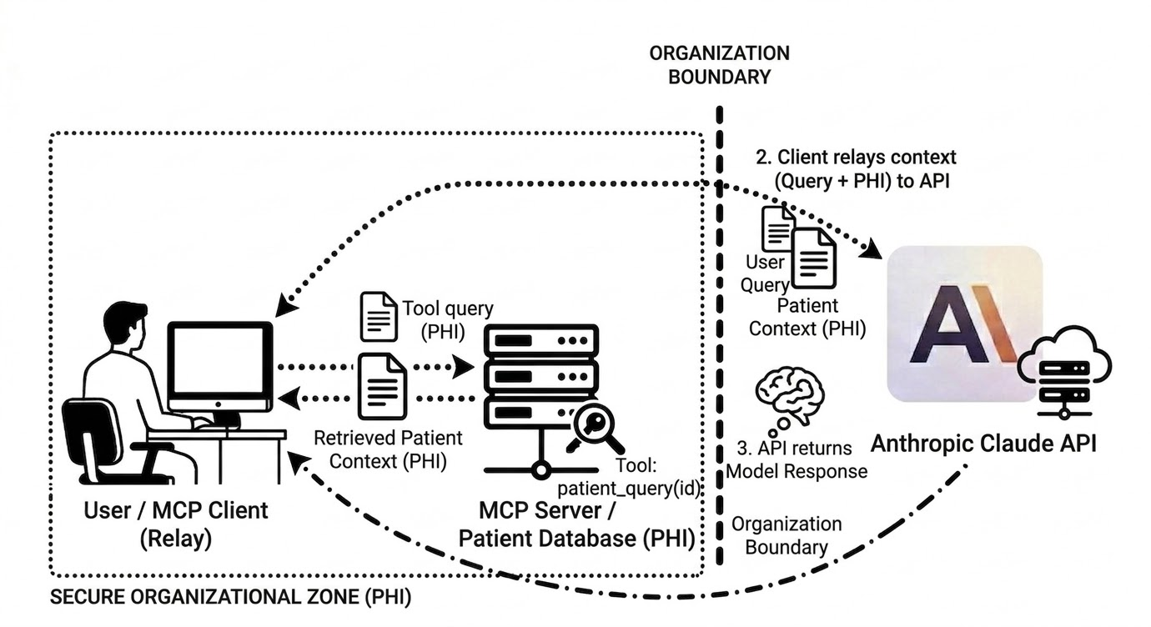
Information Security /w Agents
The Core Problem
The MCP client sends all tool results and prompts to the LLM API. If the agent reads a sensitive file, that data goes over the wire. The LLM cannot reason about information it does not see.
Mitigation Approaches
Contractual Controls — Enterprise API agreements (data not used for training, short retention)
Self-Hosted / VPC — Model runs inside company’s cloud boundary (AWS Bedrock, Google Vertex, Azure)
Proxy / Gateway Layer — DLP and PII redaction between client and API (tradeoff: can break reasoning)
Restricting Tool Access — Limit what the MCP server can reach; permission systems (Claude Code’s allow/deny)

Slide 16
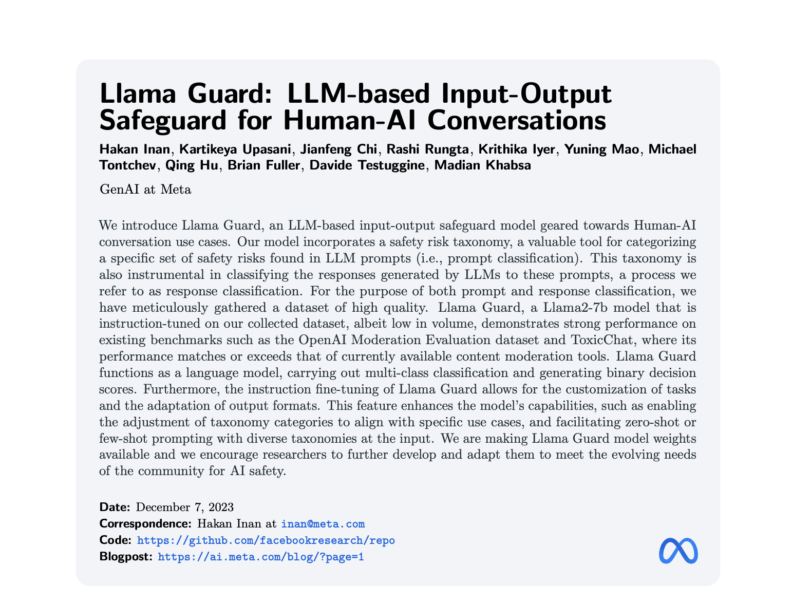
'Managing’ Conversations

Slide 17
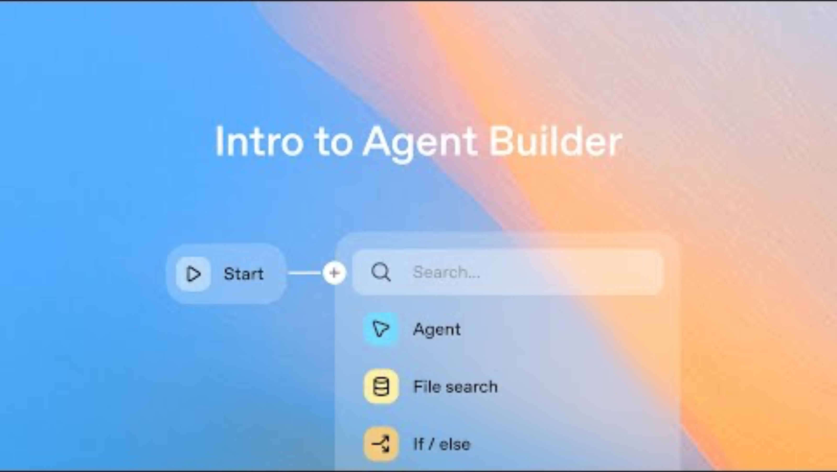
Agentic Workflows
Events Trigger Agentic Processes
Programmatically, an email might come in that triggers a series of actions involving agentic models and tools. Agents may invoke / communicate with other agents. Many graphical agentic workflow design tools are now becoming available to enable no-code development.

